Slide 1
Unit 2
Process
and
Process Scheduling

Slide 2
1. Major Requirements of an Operating System
Interleave the execution of several processes to maximize processor utilization while providing reasonable response time
Allocate resources to processes
Support inter-process communication and
Creation of user processes

Slide 3
2. Process
Also called a task
Execution of an individual program
Can be traced
  list the sequence of instructions that execute

Slide 4
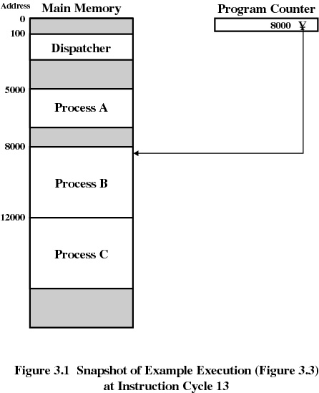

Slide 5
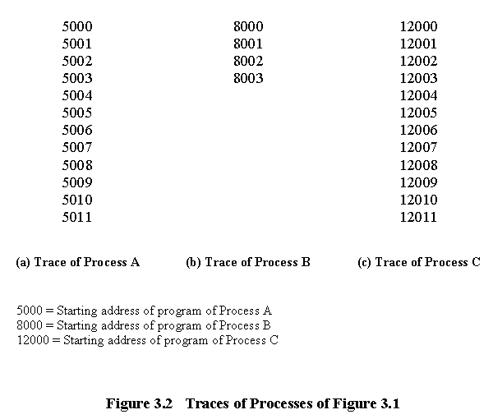

Slide 6
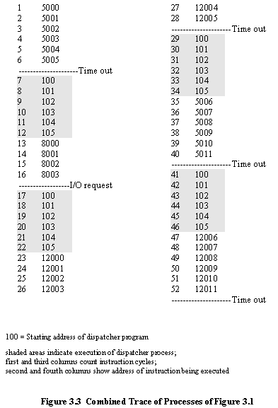

Slide 7
3. Process Creation (how?)
Submission of a batch job
User logs on
Created to provide a service such as printing
Process creates another process
Batch job issues Halt instruction
User logs off
Quit an application
Error and fault conditions

Slide 8
Reasons for Process Termination
Normal completion
Time limit exceeded
Memory unavailable
Bounds violation
Protection error
  example write to read-only file
Arithmetic error
Time overrun
  process waited longer than a specified maximum for an event

Slide 9
Reasons for Process Termination
I/O failure
Invalid instruction
  happens when try to execute data
Privileged instruction
Data misuse
Operating system intervention
  such as when deadlock occurs
Parent terminates so child processes terminate
Parent request

Slide 10
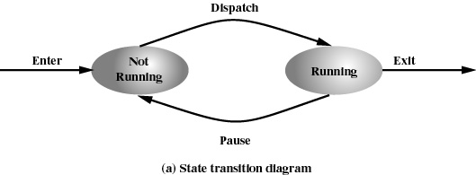
4. Two-State Process Model
Process may be in one of two states
  Running
  Not-running

Slide 11
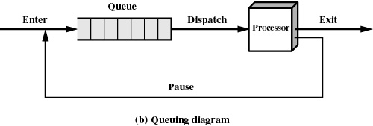
Not-Running Process in a Queue

Slide 12
Processes
Not-running
  ready to execute
Blocked
  waiting for I/O
Dispatcher cannot just select the process that has been in the queue the longest because it may be blocked

Slide 13
5. A Five-State Model
Running
Ready
Blocked
New
Exit

Slide 14
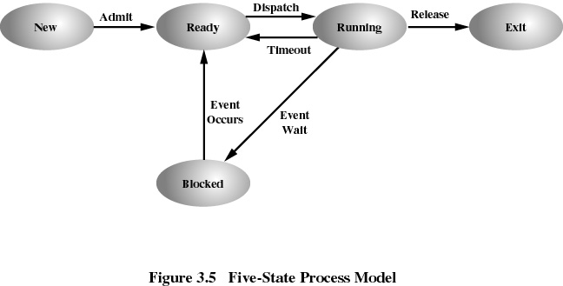

Slide 15
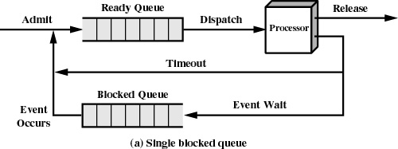
Using Two Queues

Slide 16
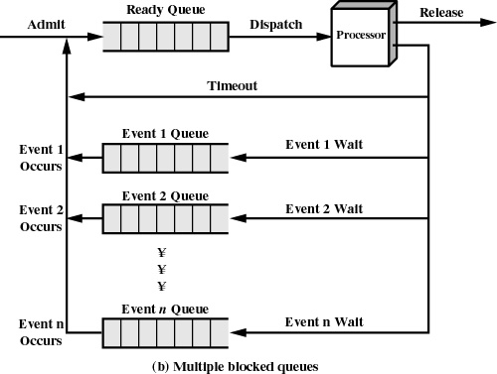

Slide 17
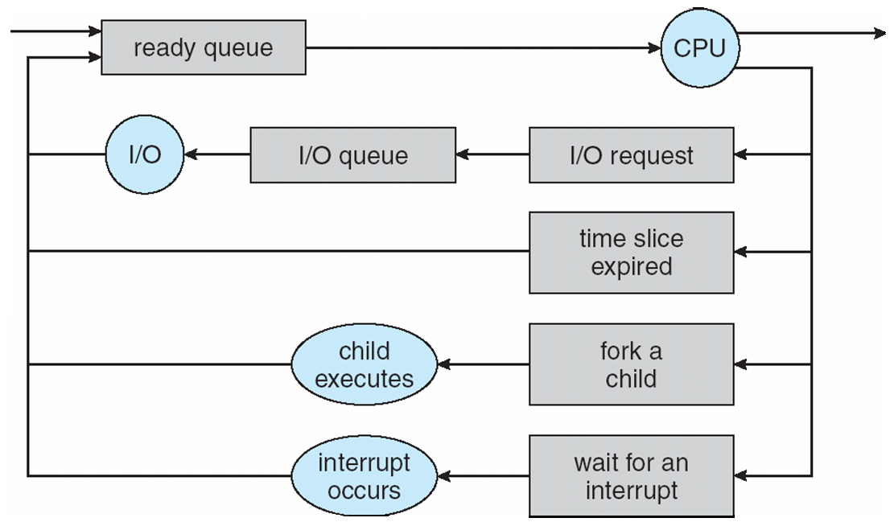
Example

Slide 18
6. Suspended Processes
Processor is faster than I/O so all processes could be waiting for I/O
Swap these processes to disk to free up more memory
Blocked state becomes suspend state when swapped to disk
Two new states
  Blocked, suspend
  Ready, suspend

Slide 19
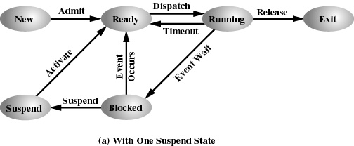
One Suspend State

Slide 20
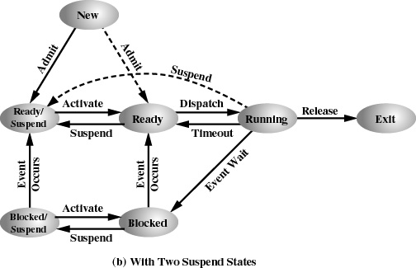
Two Suspend States

Slide 21
7. Operating System Control Structures
Information about the current status of each process and resource
Tables are constructed for each entity the operating system manages

Slide 22
7.a Memory Tables
Allocation of main memory to processes
Allocation of secondary memory to processes
Protection attributes for access to shared memory regions
Information needed to manage virtual memory

Slide 23
7.b I/O Tables
I/O device is available or assigned
Status of I/O operation
Location in main memory being used as the source or destination of the I/O transfer

Slide 24
7.c File Tables
Existence of files
Location on secondary memory
Current Status
Attributes
Sometimes this information is maintained by a file-management system

Slide 25
7.d Process Table
Where process is located
Attributes necessary for its management
  Process ID
  Process state
  Location in memory

Slide 26
Process Location
Process includes set of programs to be executed
  Data locations for local and global variables
  Any defined constants
  Stack
Process control block
  Collection of attributes
Process image
  Collection of program, data, stack, and attributes

Slide 27
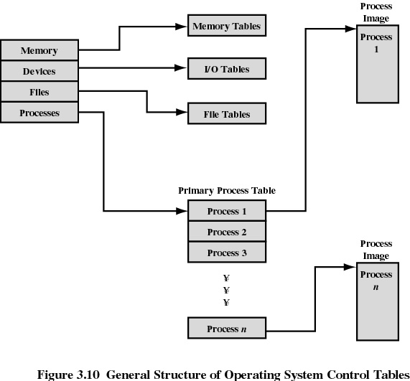

Slide 28
8. Process Control Block
1. Process identification
  (Identifiers)
    Numeric identifiers that may be stored with the process control block include
    Identifier of this process
    Identifier of the process that created this process (parent process)
    User identifier

Slide 29
Process Control Block
2. Processor State Information
2.1 User-Visible Registers
    A user-visible register is one that may be referenced by means of the machine language that the processor executes.
    Typically, there are from 8 to 32 of these registers, although some RISC implementations have over 100.

Slide 30
Process Control Block
Processor State Information (contd..)
2.2 Control and Status Registers
    These are a variety of processor registers that are employed to control the operation of the processor. These include
    • Program counter: Contains the address of the next instruction to be fetched
    • Condition codes: Result of the most recent arithmetic or logical operation (e.g., sign, zero, carry, equal, overflow)
    • Status information: Includes interrupt enabled/disabled flags, execution mode

Slide 31
Process Control Block
Processor State Information (contd…..)
  Stack Pointers
    Each process has one or more last-in-first-out (LIFO) system stacks associated with it.
    A stack is used to store parameters and calling addresses for procedure and system calls.
    The stack pointer points to the top of the stack.

Slide 32
Process Control Block
3. Process Control Information
3.1 Scheduling and State Information
    This is information that is needed by the operating system to perform its scheduling function.
    Typical items of information:
    • Process state: defines the readiness of the process to be scheduled for execution (e.g., running, ready, blocked, halted, exit).
    • Priority: One or more fields may be used to describe the scheduling priority of the process.

Slide 33
Process Control Block
    Scheduling and State Information (contd…)
    Scheduling-related information: This will depend on the scheduling algorithm used.
    Examples:- the amount of time that the process has been waiting and
    the amount of time that the process executed the last time it was running.
    Event: Identity of event the process is awaiting before it can be resumed

Slide 34
Process Control Block
Process Control Information (contd…)
  Data Structuring
    A process may be linked to other process in a queue, ring, or some other structure.
    For example, all processes in a waiting state for a particular priority level may be linked in a queue.
    A process may exhibit a parent-child (creator-created) relationship with another process.
    The process control block may contain pointers to other processes to support these structures.

Slide 35
Process Control Block
Process Control Information (contd…..)
  Inter-process Communication
    Various flags, signals, and messages may be associated with communication between two independent processes.
    Some or all of this information may be maintained in the process control block.
  Process Privileges
    Processes are granted privileges in terms of the memory that may be accessed and the types of instructions that may be executed.
    In addition, privileges may apply to the use of system utilities and services.

Slide 36
Process Control Block
Process Control Information (contd….)
  Memory Management
    This section may include pointers to segment and/or page tables that describe the virtual memory assigned to this process.
  Resource Ownership and Utilization
    Resources controlled by the process may be indicated, such as opened files.
    A history of utilization of the processor or other resources may also be included; this information may be needed by the scheduler.

Slide 37
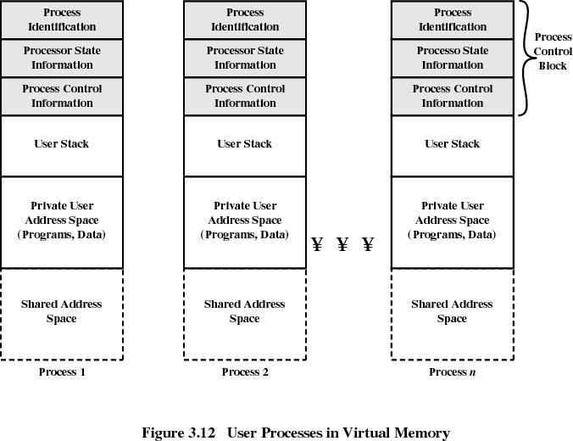

Slide 38
9. Processor State Information
Contents of processor registers
  User-visible registers
  Control and status registers
  Stack pointers
Program status word (PSW)
  contains status information
  Example: the EFLAGS register on Pentium machines

Slide 39
Modes of Execution
User mode
  Less-privileged mode
  User programs typically execute in this mode
System mode, control mode, or kernel mode
  More-privileged mode
  Kernel of the operating system

Slide 40
Process Creation
Assign a unique process identifier
Allocate space for the process
Initialize process control block
Set up appropriate linkages
  Ex: add new process to linked list used for scheduling queue
Create or expand other data structures
  Ex: maintain an accounting file

Slide 41
When to Switch a Process ?
Clock interrupt
  process has executed for the maximum allowable time slice
I/O interrupt
Memory fault
  memory address is in virtual memory so it must be brought into main memory

Slide 42
When to Switch a Process
Trap
  error occurred
  may cause process to be moved to Exit state
Supervisor call
  such as file open

Slide 43
Change of Process State
Save context of processor including program counter and other registers
Update the process control block of the process that is currently running
Move process control block to appropriate queue - ready, blocked
Select another process for execution

Slide 44
Change of Process State
Update the process control block of the process selected
Update memory-management data structures
Restore context of the selected process

Slide 45

Switching between the Processes (context switch)
Trap
  error occurred
  may cause process to be moved to Exit sta
Supervisor call
  such as file open

Slide 46
10. Execution of the Operating System
Non-process Kernel
  execute kernel outside of any process
  operating system code is executed as a separate entity that operates in privileged mode
Execution Within User Processes
  operating system software within context of a user process
  process executes in privileged mode when executing operating system code

Slide 47
Execution of the Operating System
Process-Based Operating System
  major kernel functions are separate processes
  Useful in multi-processor or multi-computer environment

Slide 48
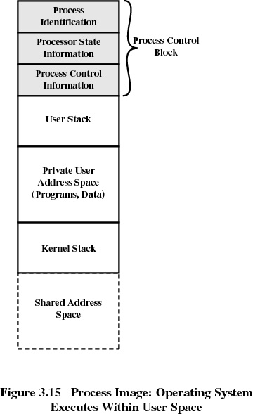

Slide 49
11. Schedulers
Long-term scheduler (or job scheduler) – selects which processes should be brought into the ready queue
Short-term scheduler (or CPU scheduler) – selects which process should be executed next and allocates CPU

Slide 50
Schedulers (Cont)
Short-term scheduler is invoked very frequently (milliseconds) ⇒ (must be fast)
Long-term scheduler is invoked very infrequently (seconds, minutes) ⇒ (may be slow)
The long-term scheduler controls the degree of multiprogramming
Processes can be described as either:
  I/O-bound process – spends more time doing I/O than computations, many short CPU bursts
  CPU-bound process – spends more time doing computations; few very long CPU bursts

Slide 51

Addition of Medium Term Scheduling

Slide 52
12. Process Scheduling
Basic Concepts
Scheduling Criteria
Scheduling Algorithms
Thread Scheduling
Multiple-Processor Scheduling
Operating Systems Examples
Algorithm Evaluation

Slide 53
A. Scheduling Objectives
To introduce process scheduling, which is the basis for multi-programmed operating systems
To describe various process-scheduling algorithms
To discuss evaluation criteria for selecting a process-scheduling algorithm for a particular system

Slide 54
B. Basic Concepts
Maximum CPU utilization obtained with multiprogramming
Process execution time consists of CPU execution time and I/O wait time
  CPU burst distribution
  CPU – I/O Burst Cycle

Slide 55


Slide 56
C. CPU Scheduler
Selects from among the processes in memory that are ready to execute, and allocates the CPU to one of them
CPU scheduling decisions may take place when a process:
  1. Switches from running to waiting state
  2. Switches from running to ready state
  3. Switches from waiting to ready
  4. Terminates
Scheduling under 1 and 4 is non-preemptive
All other scheduling is preemptive

Slide 57
Dispatching
Dispatcher module gives control of the CPU to the process selected
  switching context
  switching to user mode
  jumping to the proper location in the user program to restart that program
Dispatch latency – time it takes for the dispatcher to stop one process and start execution of another

Slide 58
D. Scheduling Criteria
CPU utilization – keep the CPU as busy as possible
Throughput – # of processes that complete their execution per time unit
Turnaround time – amount of time to execute a particular process
Waiting time – amount of time a process has been waiting in the ready queue
Response time – amount of time it takes from when a request was submitted until the first response is produced, not output (for time-sharing environment)

Slide 59
E. Scheduling Algorithm Optimization Criteria
Max CPU utilization
Max throughput
Min turnaround time
Min waiting time
Min response time

Slide 60
1. First-Come, First-Served (FCFS) Scheduling
Process Burst Time
P₁ 24
P₂ 3
P₃ 3
Suppose that the processes arrive in the order: P₁ , P₂ , P₃
The Gantt Chart for the schedule is:
Waiting time for P₁ = 0; P₂ = 24; P₃ = 27
Average waiting time: (0 + 24 + 27)/3 = 17
P₁
P₂
P₃
0
24
27
30

Slide 61
FCFS Scheduling (Cont)
Suppose that the processes arrive in the order
P₂ , P₃ , P₁
The Gantt chart for the schedule is:
Waiting time for P₁ = 6; P₂ = 0; P₃ = 3
Average waiting time: (6 + 0 + 3)/3 = 3
Much better than previous case
Convoy effect short process behind long process
P₂
P₃
P₁
0
3
6
30

Slide 62
2. Shortest-Job-First (SJF) Scheduling
Associate with each process the length of its next CPU burst. Use these lengths to schedule the process with the shortest time
SJF is optimal – gives minimum average waiting time for a given set of processes
  The difficulty is knowing the length of the next CPU request

Slide 63
Example of SJF
Process Arrival time Burst time
P₁ 0.0 6
P₂ 2.0 8
P₃ 4.0 7
P₄ 5.0 3
SJF scheduling chart
Average waiting time = (3 + 16 + 9 + 0) / 4 = 7
P₄
P₁
P₃
P₂
0
3
9
16
24

Slide 64
3. Priority Scheduling
A priority number (integer) is associated with each process
The CPU is allocated to the process with the highest priority (smallest integer ≡ highest priority)
  Preemptive
  Non-preemptive
SJF is a priority scheduling where priority is the predicted next CPU burst time
Problem ≡ Starvation – low priority processes may never execute
Solution ≡ Aging – as time progresses increase the priority of the process

Slide 65
4. Round Robin (RR)
Each process gets a small unit of CPU time (time quantum), usually 10-100 milliseconds. After this time has elapsed, the process is preempted and added to the end of the ready queue.
If there are n processes in the ready queue and the time quantum is q, then each process gets 1/n of the CPU time in chunks of at most q time units at once. No process waits more than (n-1)q time units.
Performance
  q large ⇒ FIFO
  q small ⇒ q must be large with respect to context switch, otherwise overhead is too high

Slide 66
Example of RR with Time Quantum = 4
Process Burst Time
P₁ 24
P₂ 3
P₃ 3
The Gantt chart is:
Typically, higher average turnaround than SJF, but better response
P₁
P₂
P₃
P₁
P₁
P₁
P₁
P₁
0
4
7
10
14
18
22
26
30

Slide 67

Time Quantum and Context Switch Time

Slide 68

Turnaround Time Varies With The Time Quantum

Slide 69
5. Multilevel Queue
Ready queue is partitioned into separate queues:
foreground (interactive)
background (batch)
Each queue has its own scheduling algorithm
  foreground – RR
  background – FCFS
Scheduling must be done between the queues
  Fixed priority scheduling; (i.e., serve all from foreground then from background). Possibility of starvation.
  Time slice – each queue gets a certain amount of CPU time which it can schedule amongst its processes; i.e., 80% to foreground in RR
  20% to background in FCFS

Slide 70
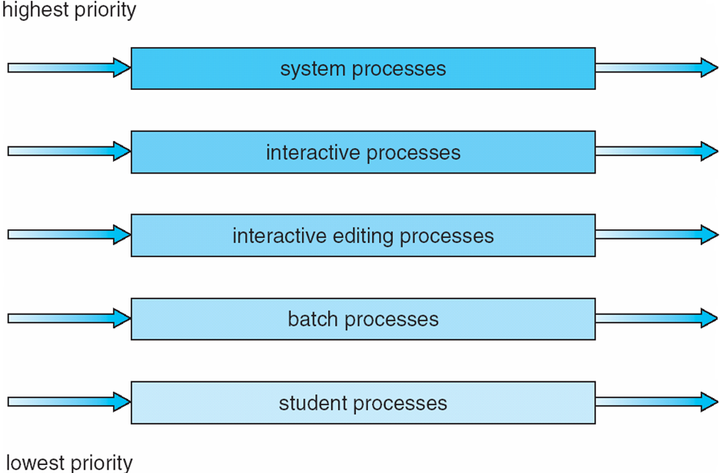
Multilevel Queue Scheduling

Slide 71
6. Multilevel Feedback Queue
A process can move between the various queues; aging can be implemented this way
Multilevel-feedback-queue scheduler defined by the following parameters:
  number of queues
  scheduling algorithms for each queue
  method used to determine when to upgrade a process
  method used to determine when to demote a process
  method used to determine which queue a process will enter when that process needs service

Slide 72
Example:
Three queues:
  Q₀ – RR with time quantum 8 milliseconds
  Q₁ – RR time quantum 16 milliseconds
  Q₂ – FCFS
Scheduling
  A new job enters queue Q₀ which is served FCFS. When it gains CPU, job receives 8 milliseconds. If it does not finish in 8 milliseconds, job is moved to queue Q₁.
  At Q₁ job is again served FCFS and receives 16 additional milliseconds. If it still does not complete, it is preempted and moved to queue Q₂.

Slide 73
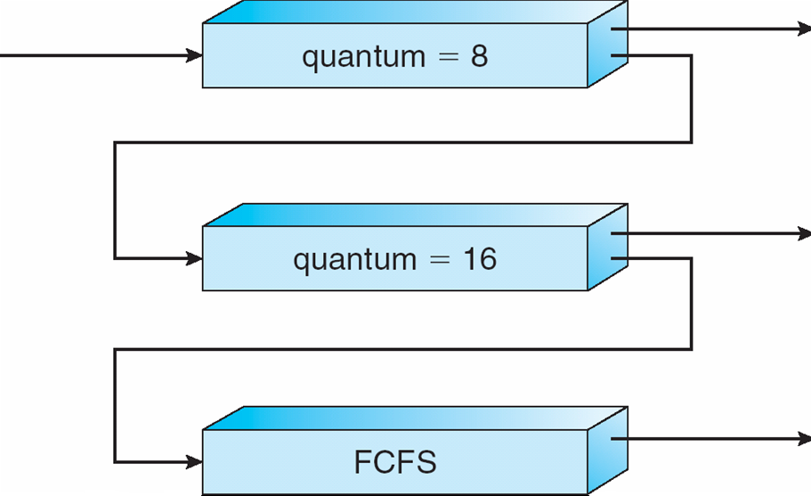
Multilevel Feedback Queues

